Slide 1

DriverPass System Analysis
Brendan Clarke
Notes:
[No speaker notes required for this slide.]

Slide 2

System Requirements
Two system functional requirements for our Drive Pass Project:
-The System shall validate Appointment scheduling with a driving instructor, it cannot just be users making random time slots, an instructor must be available.
-The System shall require users to have a username and password to a matching account to have access to the system, as well as it validating with an MFA system.
Two system non-functional requirements:
-One nonfunctional requirement the system needs to be running on a web based environment to ensure it can accessed on the road and on a computer.
-Another nonfunctional requirement has to do with usernames, a username can be any combination of numbers and letters but an additional 4 numbers will be added on to the end of every username to ensure users can share user names.
Notes:
I selected to describe the appointment validation with a driving instructor every time an appointment is created to ensure an instructor is available and that it is during hours when appointments are available. Another functional requirement for user access to the system. It requires them to have access to a username and password which can match one that is created in the database, additionally, they will need to have access to the MFA device which was established upon creation of the account. The two nonfunctional requirements I have listed here are the requirement of the system to be a web-based application, this is to ensure it is accessible from either mobile device or computer no matter where it is accessed from. On the road training will utilize this feature best as an instructor will be able to add feedback or comments during the appointment. Additionally, another nonfunctional requirement is that usernames will be any user chosen combination of numbers and letters, and an additional random set of 4 numbers, an example of two similar usernames would be Brian#1521 meaning if someone else wanted the username Brian they would be able to set that username and get an additional radom set of numbers that do not match any other “brain”s’

Slide 3
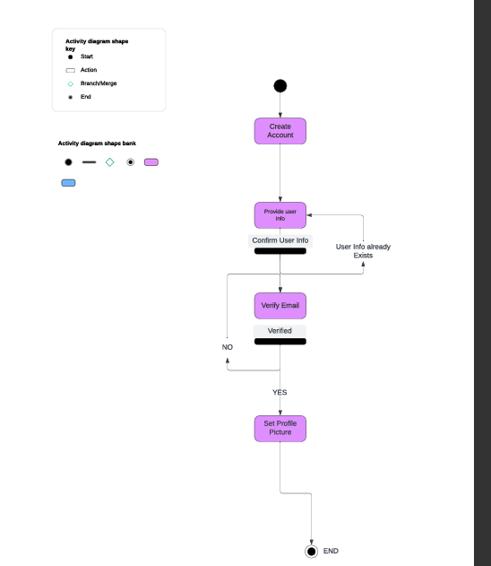
Use Case Diagram
Notes:
There is an example of the user flow diagram for creating an account, in this process we see the user info combined not to match an already existing user, this will be an email address. This will ensure if a user forgot that they created an account they would be able to see an account was already created. Additionally, this meets the security requirements for account creation with a username and password which matches the minimum-security requirements.

Slide 4
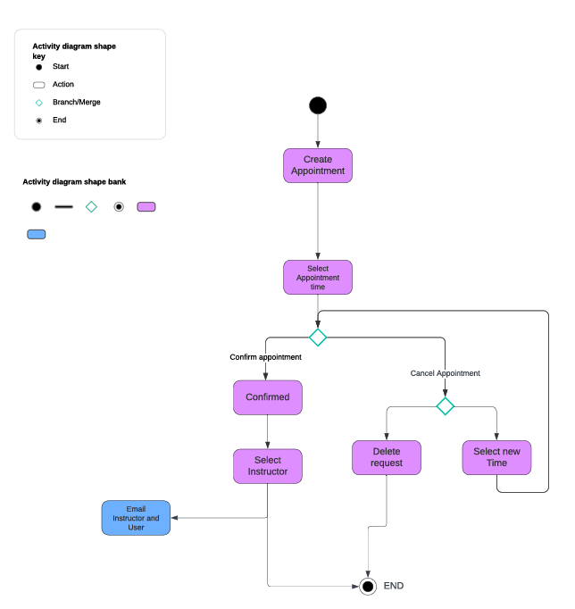
Activity Diagram
Notes:
In this activity diagram we are explaining the process for how a user or student would create an appointment. There is a few requirements to be able to confirm an appointment, they must choose an available time slot, this means an instructor must be available during that time, when they go to the next step of confirming the appointment, they will have to select based on a list of available instructors. There is also the ability to back out of the appointment creation, this is to make sure if you accidentally create an appointment, it is easy and quick to cancel it.

Slide 5
Security
A primary security feature of our system will be the user accounts security, a user can only access their account if they establish a secure password and a device for use as a MFA method.
The data which is stored on our system, everything from user info, card information, and appointment data will all be held on secure severs using the best available data encryption, and only accessible via the entitled users and administrators.
Notes:
In our case we are holding a lot of user data, we will hold a username, a password, email address, and credit or debit payments. We might also need to hold driving permits for regulatory reasons in some states. This would need to be secure in an encrypted server. Additionally, another important security feature would be that a username and password that is existing in the database will only give access to the matching user profile. This will also require the user to have access to the MFA device which is initially setup with the account.

Slide 6
System Limitations
The system has budget constraints, so ensuring we use adaptable hardware to make sure we only use cloud services and hardware which is required based on the demand is a necessity.
The system will have mobile access, but a full mobile application might have to be developed later in future, as a website which is accessible on mobile will be better for the budget constraints and efficiency of our programmers.
The system will allow instructors to write feedback on appointments, but it may be limited on how much data we can hold per appointment.
Notes:
The limitations of our design exist in a couple forms, we want our users to be able to access the system from any device, this would typically mean making two separate applications one for the website and one for the app on a mobile device, however, to keep our developing team small and efficient, we will create one system which is accessible from a web browser only. This will make it a much faster developing time too. Additionally, we should ensure the cloud servers and services which we access are adaptable and starts small. If we release to a small user base, we do not want a large-scale hardware hosting our system, we want a smaller system until we are able to grow with the system as our userbase grows.

